Slide 1
Capstone Project
Cardiovascular Disease Prediction

Slide 2
Points for Discussion
Problem Statement
Data Summary
Exploratory Data Analysis
Feature Engineering
Applying ML Algorithms
Comparing different models
Conclusion

Slide 3
Problem Statement
Cardiovascular diseases are very common these days due to the change in lifestyle and poor eating habits. So predicting the risk of cardiovascular disease for a given person by analysing his/her data from the past can save them if they act early against the disease. In this problem we are given such data of over 4000 patients on 15 different attributes from an ongoing cardiovascular study on residents of the town of Framingham, Massachusetts. The goal is to predict whether a patient has a 10-year risk of future Coronary Heart Disease (CHD).

Slide 4
Data Summary
The dataset provides the patients’ information. It includes 15 attributes. Each attribute is a potential risk factor. There are both demographic, behavioral, and medical risk factors. Let us go through each one of them.
Demographic:
Sex: male or female("M" or "F")
Age: Age of the patient
Medical(history):
BP Meds: whether or not the patient was on blood pressure medication
Prevalent Stroke: whether or not the patient had previously had a stroke
Prevalent Hyp: whether or not the patient was hypertensive
Diabetes: whether or not the patient had diabetes

Slide 5
Data Summary
Behavioral:
is_smoking: whether the patient is a current smoker ("YES" or "NO")
Cigs Per Day: the number of cigarettes that the person smoked on average in one day
Medical(current):
Tot Chol: total cholesterol level
Sys BP: systolic blood pressure
Dia BP: diastolic blood pressure
BMI: Body Mass Index
Heart Rate: heart rate
Glucose: glucose level
Predict variable(desired target):
10-year risk of coronary heart disease CHD

Slide 6
Data Summary
This Dataset contain 3390 rows and 17 columns.
Six categorical features .
We have 10 numerical feature
There are some missing Values present
There are No Duplicate values present
There are some null values present.
The dependent variable is ‘Ten-year CHD' which we need to make predictions on.

Slide 7
Data Summary
Age
CigsPerDay
TotChol
SysBP
DiaBP
BMI
HeartRate
Glucose
Sex
Is_smoking
BPMeds
PrevalentStroke
PrevalentHyp
Diabetes
Dataset
Categorical
Numerical
Target
Ten year CHD

Slide 8

EXPLORATORY DATA ANALYSIS
Exploratory Data Analysis refers to the critical process of performing initial investigations on data to discover patterns, to spot anomalies, to test hypothesis and to check assumptions with the help of summary statistics and graphical representations.

Slide 9
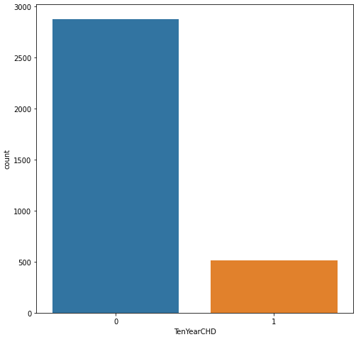
EDA
Out of 3390 given patients almost 500 patients has Cardiovascular Disease
We can see that the data set is an unbalanced dataset

Slide 10
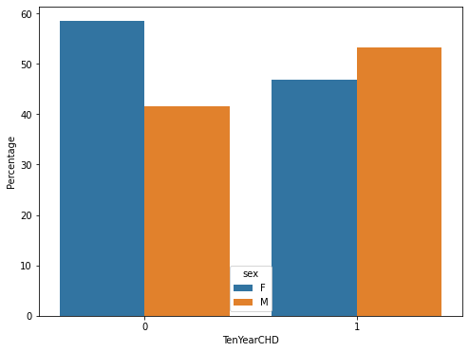
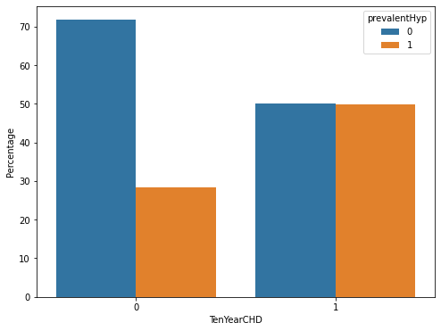
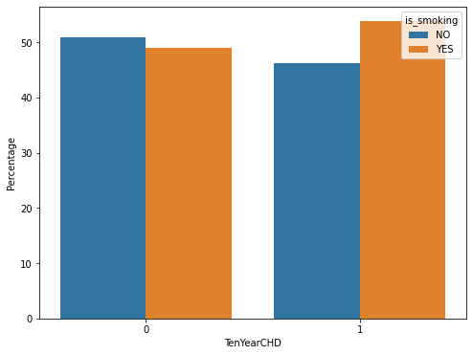
EDA
More percentage of men are at high risk for getting cardiovascular disease.
People with prevalent hypertension has 50% more chance of getting cardiovascular disease
Higher percentage of people who are smoking are at high risk.

Slide 11
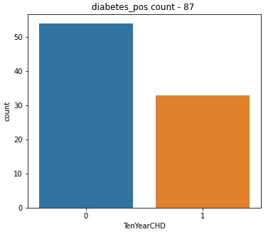
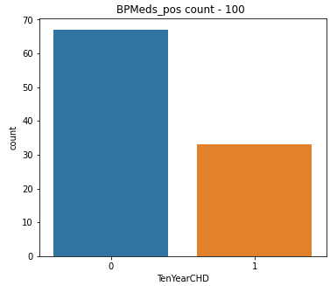
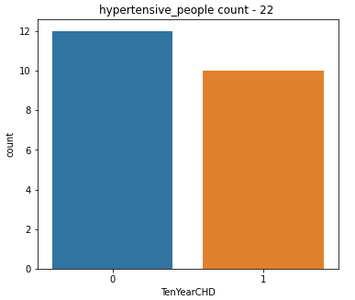
EDA
Out of 100 patients on BP medications 34 had cardiovascular disease (35%)
Out of 87 diabetic patients 35 patients had cardiovascular disease (40%)
Out of 22 Hypertensive patients 10 had cardiovascular disease (45%)

Slide 12
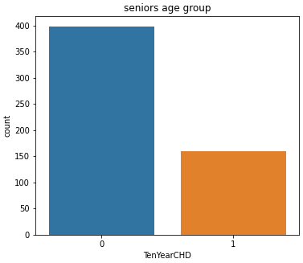
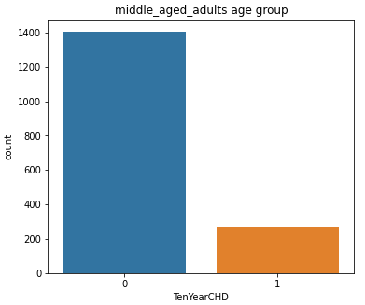
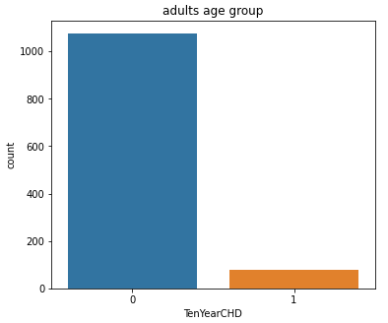
EDA
Senior age group (>60 years) are at a higher risk of cardiovascular disease
Adults age group (>32 and <47 years) are at a lower risk of cardiovascular disease
Middle-aged adults (>42 and <60 years) are at a moderate risk of cardiovascular disease
Therefore, with increasing age, the risk of cardiovascular disease increases

Slide 13
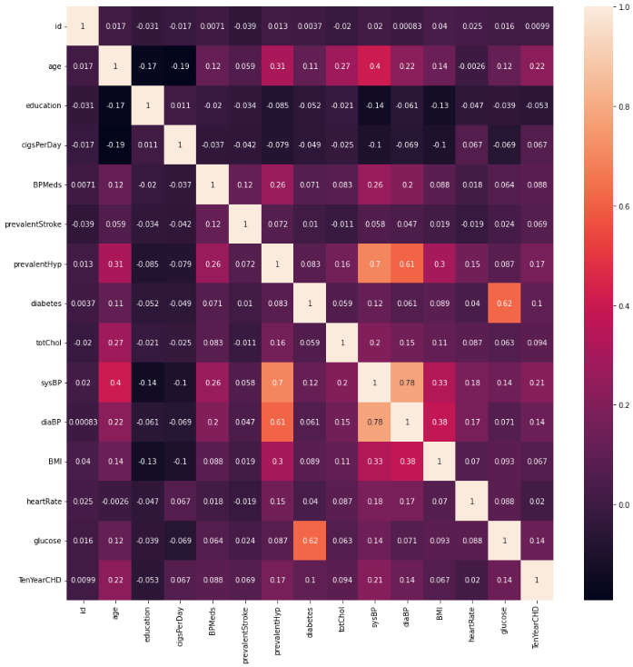
Correlation Heatmap
Most of the given variables don’t have any strong correlation with other variables
diaBP and sysBP are moderately correlated
sysBP is also moderately correlated with prevalentHyp i.e., Prevalent Hypertension
Glucose is also moderately correlated to whether patient is diabetic

Slide 14
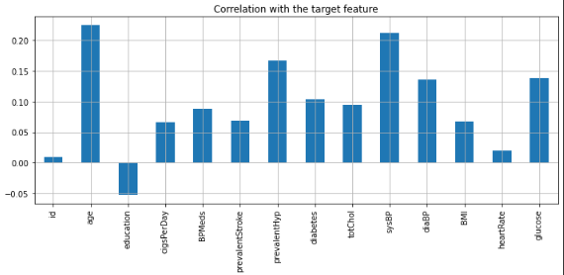
None of the independent variables is strongly correlated with target variable

Slide 15

FEATURE ENGINEERING
Feature engineering is the process of selecting, manipulating, and transforming raw data into features that can be used in supervised learning. In order to make machine learning work well on new tasks, it might be necessary to design and train better features.

Slide 16
Feature Engineering
Feature Engineering is the process of selecting, manipulating, and transforming initial variables into features that can be used in model training.
The following are the steps we have done on our data set as a part of Feature Engineering:
Null value Handling
Selecting Features
Transforming Features
Labelling the Categorical Features

Slide 17
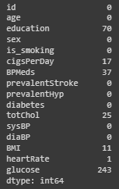
Null Values Handling
Null values are present in our data. We cannot apply ML model while null values are present.
We have used Simple Imputer to remove the null values.
For Categorical features we have imputed the null values with mode of that feature.
For Numerical features we have imputed the null values with median of that feature.

Slide 18
Selecting Features
We have used the following methods to select the relevant features from the available features.
Chi-square Test for Categorical Features
Chi-square test is used for categorical features in a dataset. We calculate Chi-square scores between each feature and the target and select the desired number of features with best Chi-square scores. It determines if the association between two categorical variables of the sample would reflect their real association in the population.
Multicollinearity for Numerical Features
We have calculated the correlation between every Numerical Feature and removed the ones having high collinearity with any of the other Numerical Feature.

Slide 19
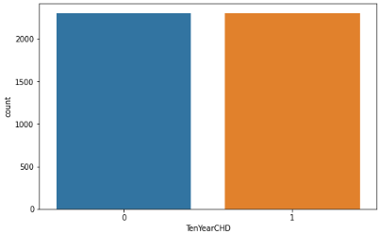
Handling Imbalanced train dataset (SMOTE)
Given data is highly imbalanced in terms of dependent variable, because very few data points are present in dataset with value of dependent variable as 1. This will affect the accuracy of our model on the test dataset. So to solve this problem we have used an oversampling technique called SMOTE to balance the training dataset.
SMOTE

Slide 20
Applying ML Algorithms
Since we have to predict whether there is 10-year risk of future coronary heart disease (CHD) or not, it is a classification problem, and we must use classification algorithms.
We have applied the following algorithms on our data:
Random Forest Classifier
Logistic regression
SVM
Gradient Boosting
KNN model

Slide 21
Applying ML Algorithms
Applying supervised ML algorithms have following steps
Preparing data for model
Training model and Hyperparameter tuning
Evaluating model on test data

Slide 22
Model training and validation
Model | Train Recall | Test Recall | Train Precision | Test Precision | Train F1- Score | Test F1- Score | Train Roc – Auc | Test Roc – Auc | Train Accuracy | Test Accuracy
Random Forest | 1 | 0.1827 | 1 | 0.2436 | 1 | 0.2088 | 1 | 0.6574 | 1 | 0.7876
Logistic Regression | 0.6824 | 0.6154 | 0.6751 | 0.2327 | 0.6787 | 0.3377 | 0.7403 | 0.6743 | 0.677 | 0.6298
GB boost | 0.8399 | 0.2788 | 0.9021 | 0.2613 | 0.8699 | 0.2698 | 0.9494 | 0.648 | 0.8744 | 0.7684
SVM | 0.7714 | 0.3942 | 0.8071 | 0.2343 | 0.7888 | 0.2939 | 0.8755 | 0.6197 | 0.7935 | 0.7094
KNN | 0.98 | 0.4712 | 0.8161 | 0.2068 | 0.8906 | 0.2874 | 0.9751 | 0.5787 | 0.8796 | 0.6416

Slide 23
Model training and validation
Observations:
All our models are overfitting as accuracy for train dataset is high and low for test dataset.
Accuracy is comparatively high for each model compared to F1-score of each model due to unbalanced nature of data.
Logistic regression performed comparatively better than all other models due to higher test F1-score.
We will use Random forest model and logistic regression model for hyperparameter tuning.

Slide 24

TRAINING AND HYPERPARAMETER TUNING
We have trained different ML models and performed hyperparameter tuning using GridSearch CV.
Following are the optimal parameters for respective models
Model | Optimal Parameters
Random Forest | criterion: gini, max_depth: 14, max_features: 0.5, max_samples: 0.7, min_samples_leaf: 17, n_estimators: 1000
Logistic Regression | C: 7.3763, penalty: l1, solver: liblinear

Slide 25
Model Evaluation after hyperparameter tuning
Model | Train Recall | Test Recall | Train Precision | Test Precision | Train F1- Score | Test F1- Score | Train Roc – Auc | Test Roc – Auc | Train Accuracy | Test Accuracy
Random Forest | 0.8503 | 0.3365 | 0.8861 | 0.2414 | 0.8678 | 0.2811 | 0.9498 | 0.669 | 0.8705 | 0.736
Logistic Regression | 0.6829 | 0.6058 | 0.677 | 0.2299 | 0.6799 | 0.3333 | 0.74 | 0.6766 | 0.6785 | 0.6283
Even after hyperparameter tuning F1-score is very low. This can be due to the nature of the data. No relation can be found between independent and dependent feature.

Slide 26
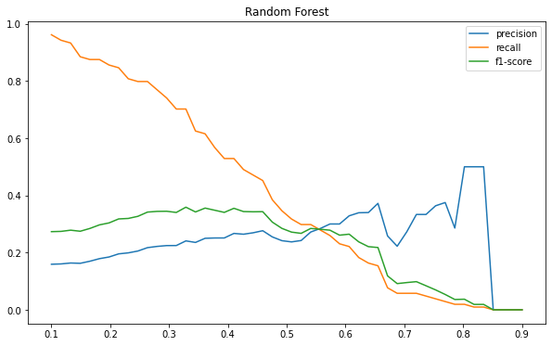
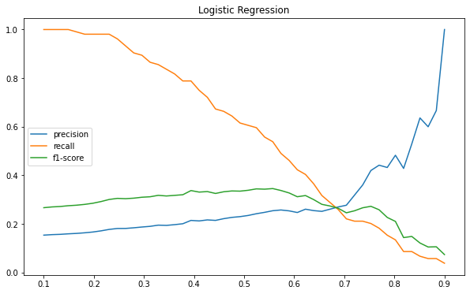
Model Evaluation at various threshold values
For various threshold values recall and F1 score for Random forest and Logistic regression are shown
We can see low threshold value cause high recall score , which is preferred while disease prediction model

Slide 27
Conclusions
Without hyperparameter tuning all the models are overfitting
F1 score didn’t improved after hyperparameter tuning this may be due to lack of specific relation between features
Logistic regression with hyperparameter tuning performed better compared to other models
Lower threshold is preferred as it is giving high recall

